Slide 1
Software Prototyping

Slide 2
Software Prototype
A prototype is an initial version of a system used to demonstrate concepts and try out design options.
A prototype can be used in:
The requirements engineering process to help with requirements elicitation and validation;
In design processes to explore options and develop a UI design;
In the testing process to validate requirement.

Slide 3
System prototyping
Prototyping is the rapid development of a system
The principal use is to help customers and
developers understand the requirements for the
system
Requirements elicitation – Users can experiment with a
prototype to see how the system supports their work
• Requirements validation – The prototype can reveal
errors and omissions in the requirements
Prototyping can be considered as a risk reduction
activity

Slide 4
Prototyping benefits
Misunderstandings between software users and
developers are exposed
Missing services may be detected and confusing
services may be identified
A working system is available early in the process
The prototype may serve as a basis for deriving a
system specification
The system can support user training and system
testing

Slide 5
Prototyping in the software process
Evolutionary prototyping: An initial prototype is produced and refined through a number of stages to the final system
Throw-away prototyping: A prototype is produced to help discover requirements problems and then discarded. The system is then developed using some other development process.
It may be impossible to tune the system to meet non-functional requirements;
Prototypes are normally undocumented;
The prototype probably will not meet normal organisational quality standards.

Slide 6
Evolutionary prototyping
Must be used for systems where the specification cannot be developed in advance
E.g., AI systems and user interface systems
Based on techniques which allow rapid system iterations

Slide 7
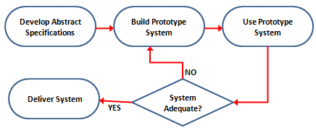
Evolutionary prototyping

Slide 8
Evolutionary prototyping advantages
Accelerated delivery of the system
User engagement with the system

Slide 9
Contd…
Specification, design and implementation are
inter-twined
The system is developed as a series of increments
that are delivered to the customer
Techniques for rapid system development are
used such as CASE tools
User interfaces are usually developed using a GUI
development toolkit

Slide 10
Evolutionary prototyping problems
Management problems
Specialist skills are required which may not be
available in all development teams
Maintenance problems
Continual change tends to corrupt system structure so long-term maintenance is expensive

Slide 11
Contd..,
Some parts of the requirements may be
impossible to prototype
E.g., safety-critical functions
An implementation has no legal standing as a
contract
Non-functional requirements cannot be
adequately tested in a system prototype

Slide 12
Throw-away prototyping
With 'throw-away' prototyping a small part of the system is developed and then given to the end user to try out and evaluate. The user provides feedback which can quickly be incorporated into the development of the main system.
The prototype is then discarded or thrown away. This is very different to the evolutionary approach.

Slide 13
Contd…
The prototype is developed from an initial
specification, delivered for experiment then
discarded
The throw-away prototype should NOT be
considered as a final system because
Some system characteristics may have been left out
There is no specification for long-term maintenance
The system will be poorly structured and difficult to maintain

Slide 14
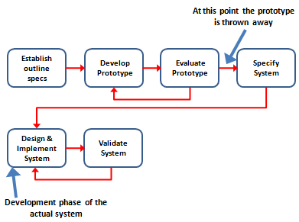
Contd..

Slide 15
Throw-Away Prototype Problems
Sometimes the cost of prototype development represents an unacceptably large fraction of the total cost
Customers are likely to force the developer to convert the prototype to the working system using a few fixes
The developer may become familiar with the prototype and reluctant to discard it

Slide 16
Rapid prototyping techniques
Rapid Prototyping (RP) enables the quick fabrication of physical models using computer aided design . Used in a wide range of industries, Rapid prototyping allows companies to turn innovative ideas into successful end products rapidly and efficiently.
Various techniques may be used for rapid
development
Dynamic high-level language development
Database programming
Component and application assembly
These techniques are often used together
Visual programming is an inherent part of most
prototype development systems

Slide 17
Why Rapid Prototyping?
To increase effective communication.
To decrease development time.
To decrease costly mistakes.
To minimize sustaining engineering changes.
To extend product lifetime by adding necessary features and eliminating redundant features early in the design.

Slide 18
Dynamic high-level languages
Languages which include powerful data
management facilities
Use of language which offer excellent UI development facilities

Slide 19
While choosing prototyping language, consider following points:
What is the application domain of the problem?
What user interaction is required?
What support environment comes with the language?
Different parts of the system may be programmed in different languages
Example languages
Java, Prolog, Perl
Different languages can be used in different part of the system but there should be proper communication between these system

Slide 20
Database programming
Various database languages are used in management of different databases
Normally include a database query language, a screen generator, a report generator and a spreadsheet
Cost-effective for small to medium sized business systems
Often called fourth generation language

Slide 21
Contd…

Slide 22
Component and application assembly
Prototypes can be created quickly from a set of
reusable components plus some mechanism to
‘glue’ these component together
l The composition mechanism must include control
facilities and a mechanism for component
communication
l The system specification must take into account
the availability and functionality of existing
components

Slide 23
Two techniques used
Application level development
Entire application systems are integrated with the prototype
so that their functionality can be shared
For example, if text preparation is required, a standard word
processor can be used
Component level development
Individual components are integrated within a standard
framework to implement the system
Framework can be a scripting language or an integration
framework such as CORBA,COM
Library of such component are maintained for rapid prototype development

Slide 24
Visual programming
Scripting languages such as Visual Basic support visual programming
the prototype is developed by creating a user interface from standard items and associating components with these items
A large library of components exists to support this type of development
These may be tailored to suit the specific application requirements

Slide 25
Visual programming with reuse

Slide 26
Problems with visual development
Difficult to coordinate team-based development
No explicit system architecture
Complex dependencies between parts of the program can cause maintainability problems

Slide 27
User interface prototyping
This method is used to pre-specify the look and feel of a user interface in an effective way
User interface generators may be used to ‘draw’ the interface and simulate its functionality with components
Web interfaces may be prototyped using a web site editor
UI development consumes an increasing part of overall system development costs
By effective user interface, the cost of overall system get increaed

